Slide 1
Welcome to the COATES House Captain Presentation!
By yohan and grace

Slide 2
Underwater fireworks

Slide 3
Apparatus:
Materials:
Vegetable oil
Food colouring
Cold water
1 Large glass
1 Small glass

Slide 4
Method:
Fill the large glass three-quarters full with water
Pour some vegetable oil into the small glass
Add food colouring to the small glass
Pour the contents of the small glass cup into the large cup

Slide 5

Prediction:
What do you think will happen when we pour the vegetable oil and food colouring into the water?

Slide 6
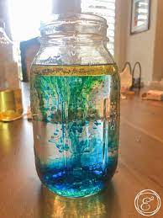
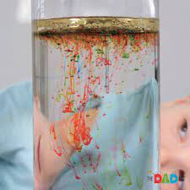
Watch the video for a result:
https://youtu.be/9J_SCQhTmcM

Slide 7
Conclusion:
Because the oil is less dense than the water, it will float at the top.
The colored droplets will begin to sink because they are heavier than the oil.
Once they sink into the water, they will begin dissolving slowly-creating the tiny ‘explosions’.

Slide 8
Thank you for watching our presentation!

