Slide 1
Elephant toothpaste
By Yeva & Maxwell
This is going to be the best experiment of your life!

Slide 2
What you need to create Elephant Toothpaste?
Apparatus:
Empty plastic or glass container
Materials:
Bicarbonate of soda
Food colouring (e.g. green, blue, red)
Vinegar
Liquid soap

Slide 3
Method:
Combine the vinegar, water, liquid soap and 2 drops of food colouring in the container.
Use a spoon to mix the bicarbonate of soda slurry until it is all a liquid.
Pour the bicarbonate of soda slurry into the container.

Slide 4

Prediction:
What do you think will happen when we add the bicarbonate of soda?
Why?

Slide 5
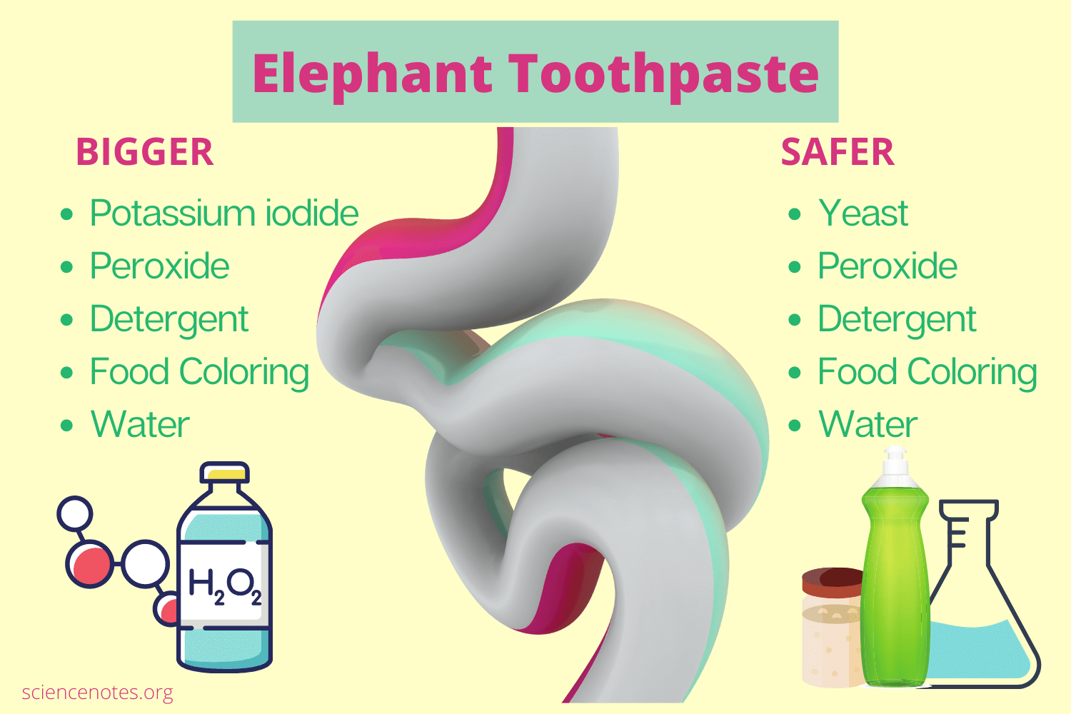
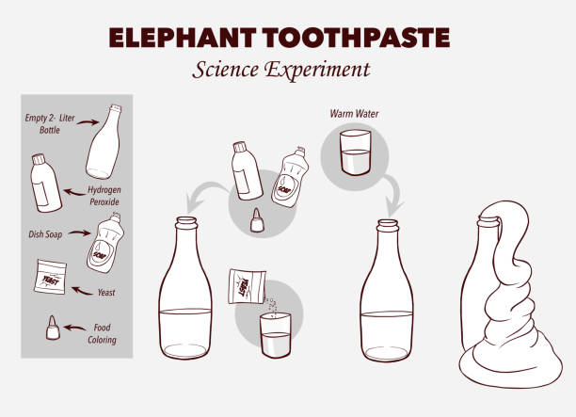
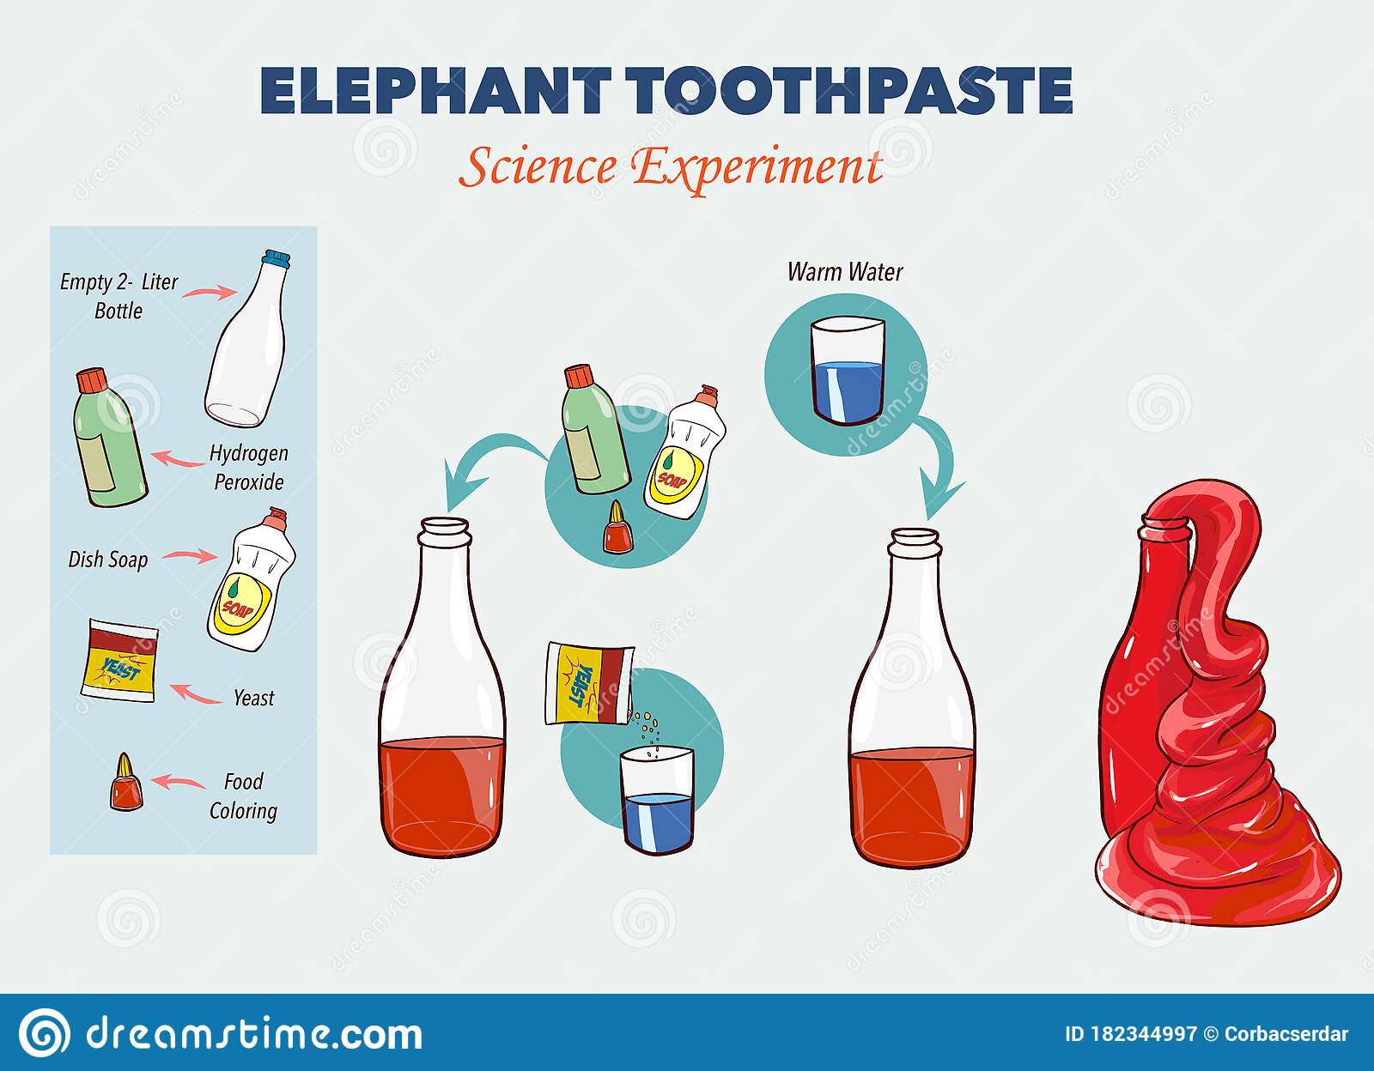
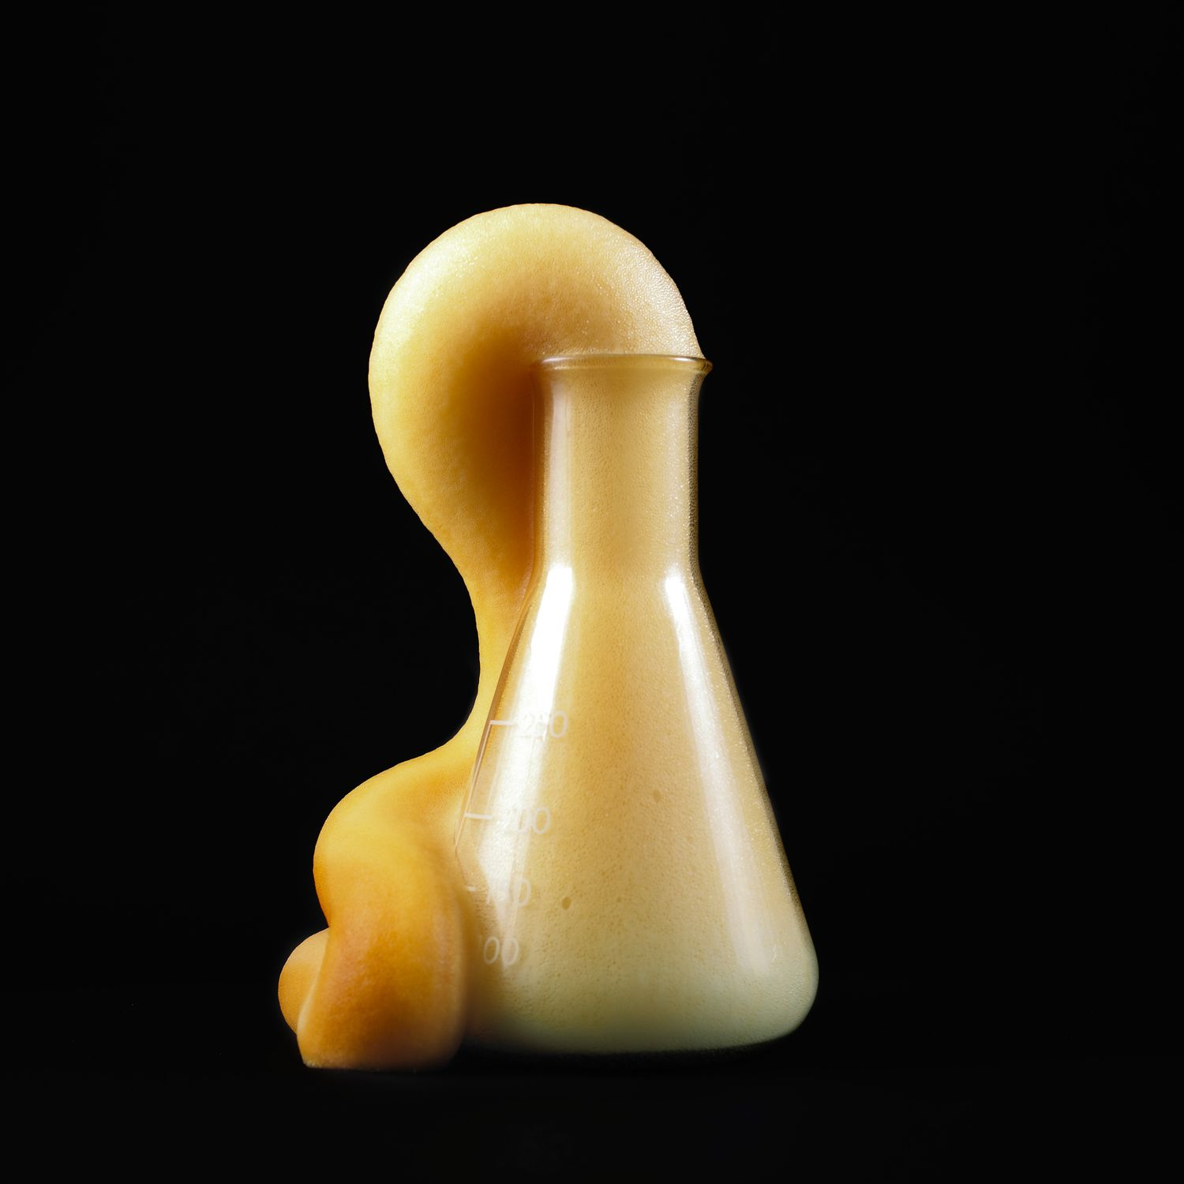
https://www.google.co.uk/search?hl&q=elephant+toothpaste+recipe+with+vinegar+and+baking+soda#kpvalbx=_XDYHZJDZNMbZgQa2-baoCg_46

Slide 6
Conclusion:
A chemical reaction between vinegar and bicarbonate of soda releases a gas called carbon dioxide.
Carbon dioxide is the same type of gas used to make the carbonation in fizzy drinks.
What happens if you shake a fizzy drink?
The gas gets very excited and tries to spread out.
There is not enough room in the bottle for the gas to spread out so it leaves through the opening very quickly, causing an eruption!

Slide 7

Thank you for watching our science experiment!
              We hope you enjoyed it.

