Slide 1
Lava Lamp
This is a fun and interesting science experiment by the Barnett House Captains
Yasir and Zohar

Slide 2
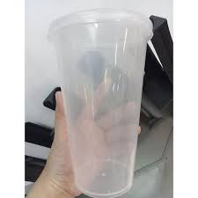
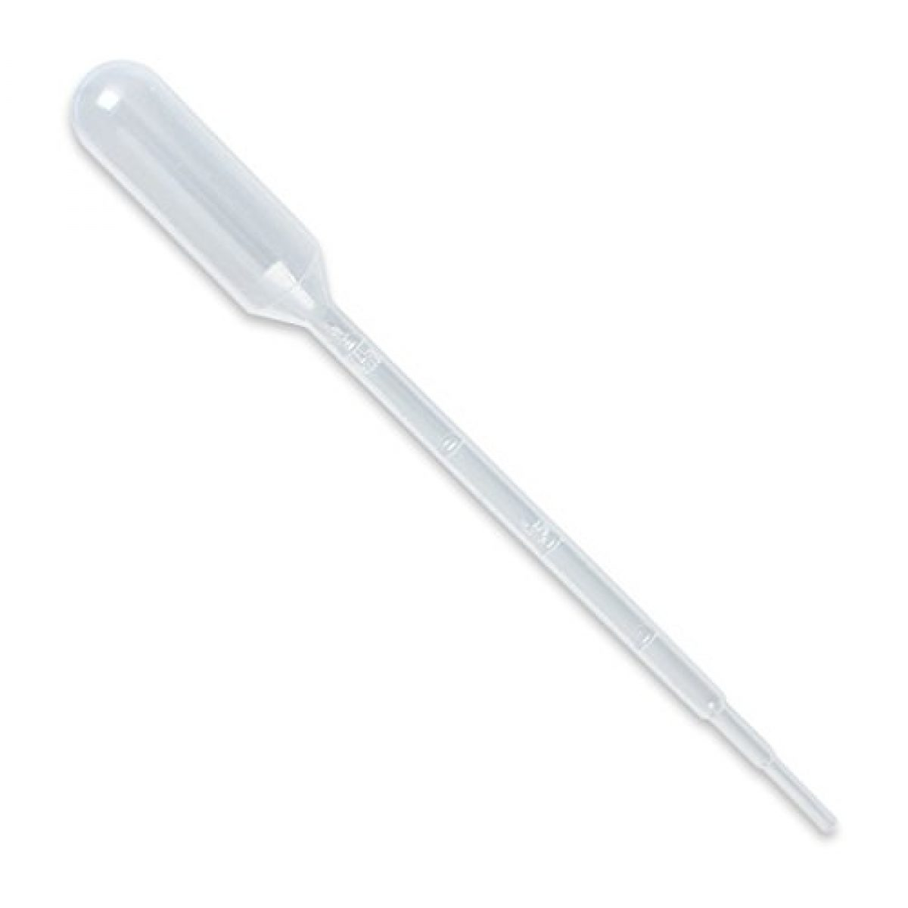
Apparatus
clean plastic or glass container
pipette
Materials
food colouring
alka-seltzer
vegetable oil
water

Slide 3
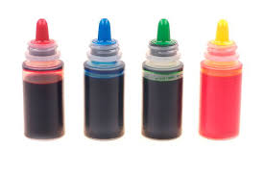
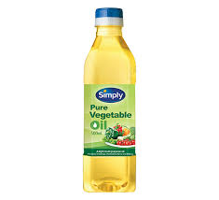
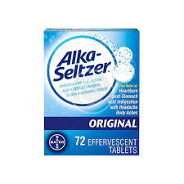
WHAT DO YOU USE TO MAKE THE LAVA LAMP?
Fill a quarter of the jar with water
Fill three quarters of the jar with oil
Add 8-10 drops of each food colouring
Add two alka-seltzer tablets

Slide 4
PREDICTION
What do you think will happen when the alka-seltzer is added to the mixture?
Why do you think this will happen?
Let’s add the alka-seltzer now and find out…

Slide 5
https://www.youtube.com/watch?v=IvcPiDvmFJM
VIDEO

Slide 6
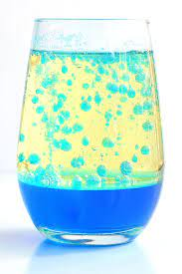
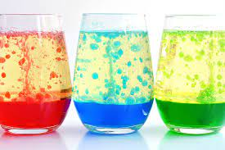
In conclusion…
Oil and water do not mix.
If you try to shake up the bottle, the oil breaks up into small little drops, but the oil does not mix with the water.
When you pour the water into the bottle with the oil, the water sinks to the bottom and the oil floats to the top.
Oil floats on the surface because water is heavier than oil. Water is more dense than the oil.
The Alka-Seltzer tablet reacts with the water to make carbon dioxide gas.
These bubbles attach themselves to the colored water and cause them to float to the surface.
When the bubbles pop, the color sinks back to the bottom of the bottle.

Slide 7

We hoped you enjoyed it !
THANK YOU FOR WATCHING OUR SCIENCE EXPERIMENT.

