Slide 1
Year 5/6 SATs Information evening
January 16th 2023 6p.m.

Slide 2
Why have we invited Y5 parents?
Feedback from parents has been ‘Wish I’d known this sooner’
Awareness of expectations can be a shock
Support with how to help at home in time

Slide 3
How do we prepare at school?
Group according to attainment for Maths in Y6
Continuous assessment
Assertive mentoring
Small group tasks to target needs
Focused Maths lessons using practice papers
Focused English lessons using practice papers
Focused SPaG lessons using practice papers
Homework tasks
Guided / independent reading

Slide 4
What can you do at home during Y5?
Ensure children complete homework to a good standard
Read regularly with and to your child and ask questions
Encourage your child to read quality texts and for a good period of time to develop reading stamina
Provide writing opportunities
Learn spellings and times tables
Purchase practice test/skills papers or download
Ensure that children are rarely absent

Slide 5
What can you do at home during Y6?
Ensure children all complete homework regularly
Encourage your child to read regularly and ask questions
Encourage your child to read quality texts and for a good period of time to develop reading stamina
Provide writing opportunities
Learn spellings and times tables
Purchase practice test/skills papers or download
Ensure that children are rarely absent
During the week of the tests, ensure that the
children are in school every day, on time and have had a
good breakfast and sleep the night before

Slide 6
SATs week dates:
Tuesday 9th - Friday 12th May 2023
Altered timetable due to King’s Coronation

Slide 7
Key information about the tests
One set of tests for each subject- reading, grammar and maths
Tests will include a small number of questions designed to assess the highest attaining pupils, so there are no separate tests
KS2 national curriculum test outcomes are reported using scaled scores

Slide 8
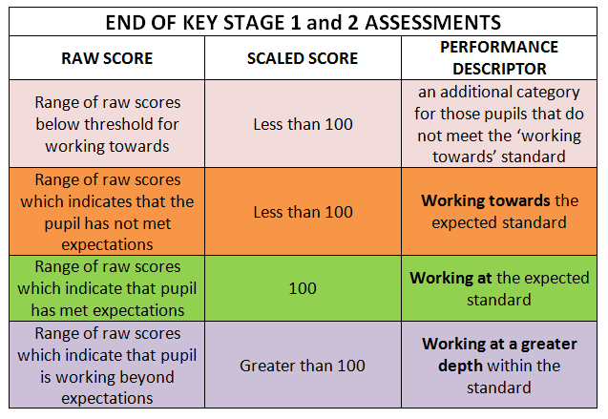
TESTS: Scaled scores

Slide 9
The KS2 tests consist of:
English grammar, punctuation and spelling Paper 1: short answer questions
English grammar, punctuation and spelling Paper 2: spelling
English reading: reading booklet and associated answer booklet
Mathematics Paper 1: arithmetic
Mathematics Paper 2: reasoning
Mathematics Paper 3: reasoning

Slide 10
Test week 2023 for Y6 pupils
 | Subject | Time | Marks/ raw score
Tuesday May 9th | English grammar, punctuation and spelling: Paper one- short answer questions | 45 min | 50
 | English grammar, punctuation and spelling: Paper 2-spelling | 15 min | 20
Wednesday May 10th | English reading: reading booklet and associated answer booklet: 3 texts | 60 min | 50
Thursday May 11th | Maths paper 1:arithmetic | 30 min | 40
 | Maths paper 2: reasoning | 40 min | 35
Friday May 12th | Maths paper 3: reasoning | 40 min | 35

Slide 11
KS2 SPaG test
National curriculum-
Sets out technical terms in grammar to be learnt - these are explicitly included in the test
Defines precise spelling patterns and methodologies to be taught - these are the basis of spellings in the test
Focus on knowing and applying grammatical terminology with the full range of punctuation tested
There will be no contextual items in the test
Paper 1: short answer questions
Paper 2: Spelling - pupils complete by writing 20 missing words from transcript read by test administrator

Slide 12
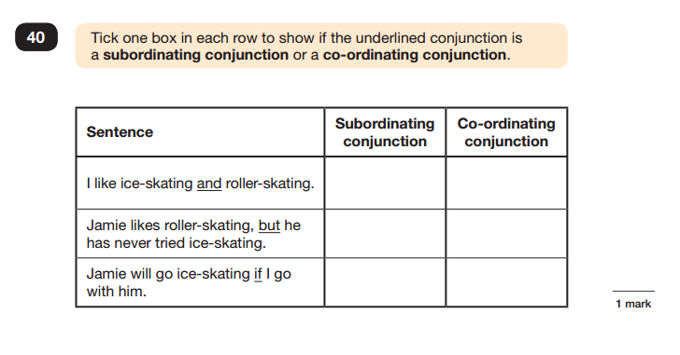

Slide 13
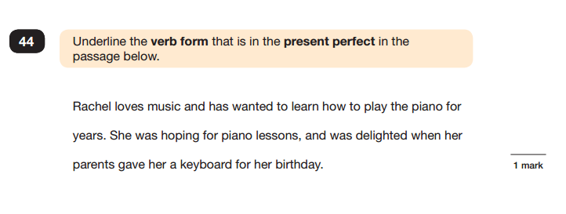

Slide 17
Spelling test words
Prefixes 3
Suffixes 2
shun endings 2
ably / ibly 2
words with silent letters 1
Homophones 1
discover
mission
loose
sign
country
gymnastics
edible
posture
sleigh
delicious
scent
illusion
re-enter
parachute
abundance
unavoidably
dissolve
ominous
drawer
possession
Spelling test

Slide 18
KS2 Reading test
greater focus on fictional texts
mixture of genres
least-demanding text first, following texts increasing in difficulty
A lot to read in the time provided
Roughly 6 sides of A4 to read and about 35 questions in 60 min
Reading stamina is key

Slide 19
Reading: question types
questions assessing vocabulary in context
requiring pupils to provide synonyms / explanation for vocabulary
Inferring from the text
requiring pupils to identify language features
Sequencing and ordering events
requiring pupils to comment on author’s choices
requiring pupils to recognise the difference between a fact and an opinion
comparison of information within the text

Slide 20
Task:
You have five minutes to read
‘Albion’s Dream’ on P8 in the booklet.

Slide 21
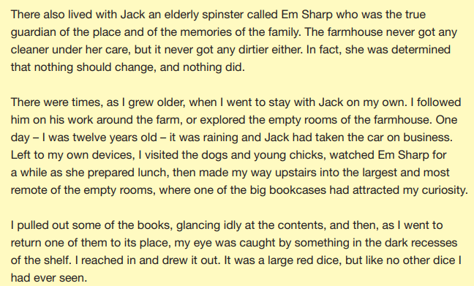
Look at page 9
Find and copy one word which shows that Emily Sharp was in charge of the house.
……………………………………………………………………………………………………………………………… 1 mark

Slide 22
Let’s look at another example:
Look at the paragraph beginning: ‘I volunteered for one of the boats…’
In this paragraph it states: ‘the men grumbled fiercely over their work.’
What does this phrase suggest about the men’s attitude towards their work? Use evidence from the text to support your answer.
…………………………………………………………………………………………………………………………………
…………………………………………………………………………………………………………………………………
…………………………………………………………………………………………………………………………………
………………………………………………………………………………………………………………………………… 3 marks

Slide 23
KS2 mathematics test
3 papers
Paper 1: Arithmetic, Paper 2: Reasoning and Paper 3: Reasoning
The arithmetic test assesses basic mathematical calculations:
-questions cover straightforward addition and subtraction
more complex calculations with fractions
long divisions and long multiplications worth 2 marks each
Papers 2 and 3 each consist of a single reasoning test paper

Slide 24
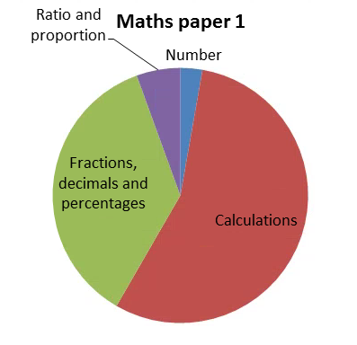
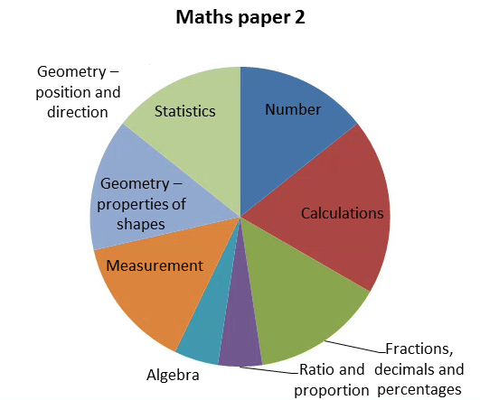
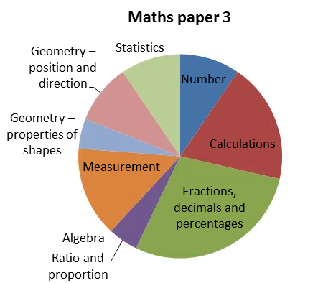

Slide 25
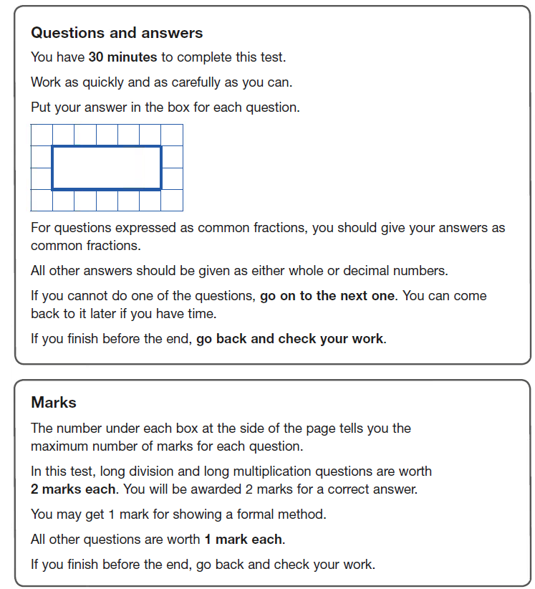
Maths paper 1: arithmetic
36 questions in 30 min
Some questions require children to show method
Questions increase in difficulty
Variations in how calculation is stated

Slide 26
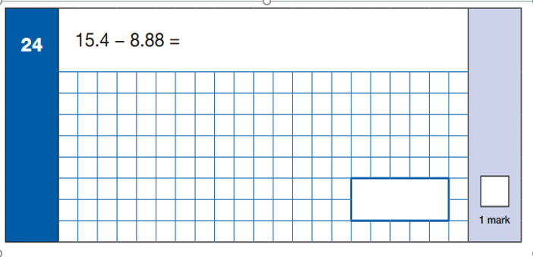

Slide 27
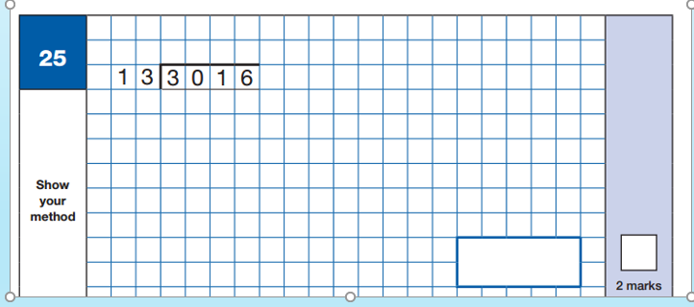
Your turn…

Slide 28
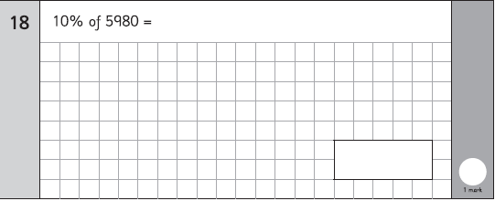

Slide 30
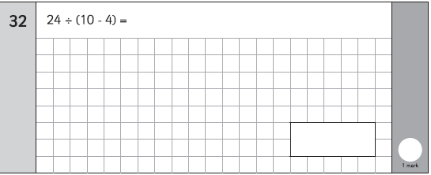
What do the children need to look out for here?

Slide 31
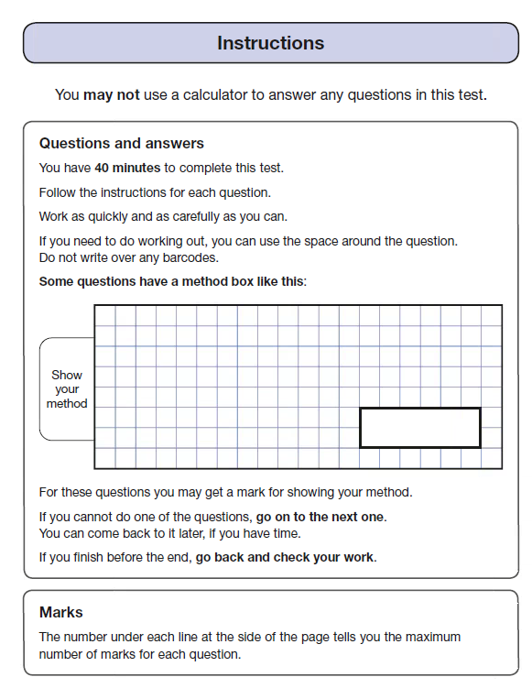
Maths papers 2 & 3: Reasoning
Potential challenges
Mathematical vocabulary
Phraseology of questions
Written explanations required
20 questions in 40 min
Variety of styles

Slide 32
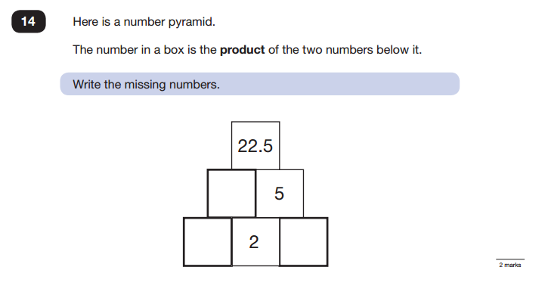

Slide 33
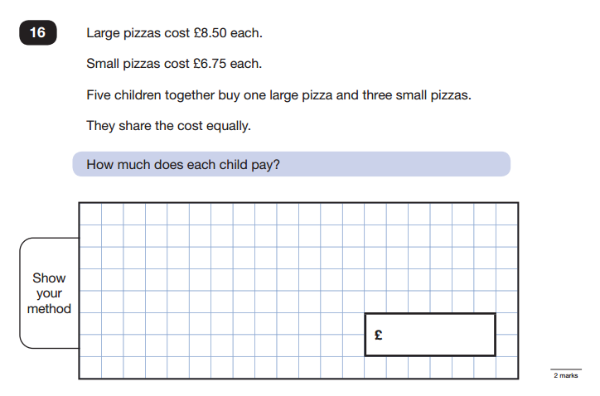

Slide 34
Teacher Assessment
As well as tests for reading, grammar and maths
there are teacher assessments made and reported to parents
Writing is teacher assessed only - there is no formal test
A range of pieces are used to assess outcome
Participation in class and attitude to learning
Effort towards homework
Regular participation in external moderation to ensure consistency of judgements

Slide 35
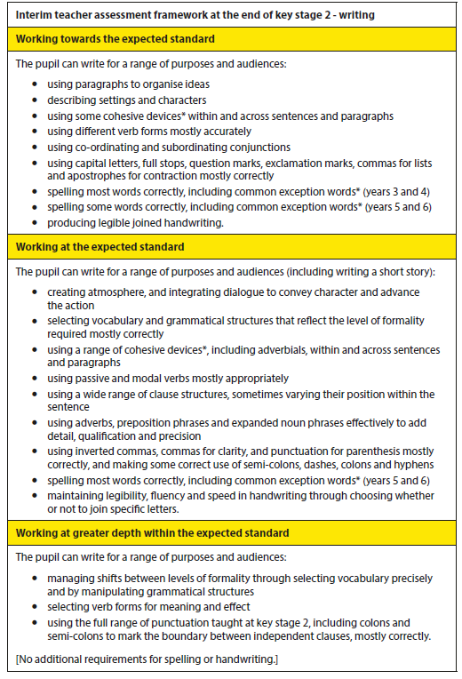
Writing standards:

Slide 36
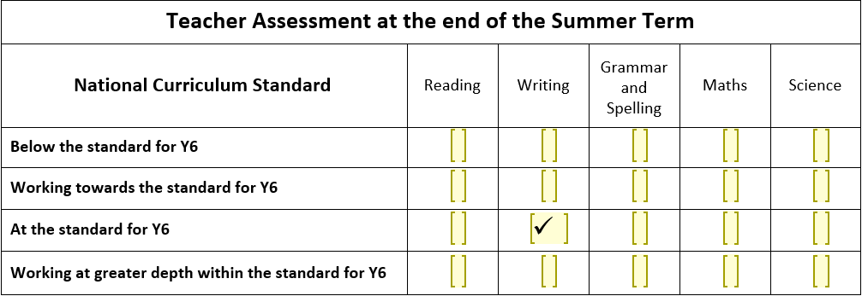

Slide 37
After the SATs
Reading, SPAG and Maths Papers will be sent away
to external markers
Return the first week of July
Analysis of the results
Reporting to parents

Slide 38
Help us to help them
We strive to maintain a normal timetable - a balance of all subjects - not just test subjects
We value all the work they have done over the last four years and encourage the importance of them achieving the highest score they can
We make it clear that whatever school they are going to, or planning to try for - their results are important and used by their teachers to set them
We ensure the children experience as little stress as possible
We need you to give them the same message

Slide 39
Year 6 There are only 62 teaching days until SATs!
Any questions?

