Slide 1

Year 5/6 SATs Information evening
Monday January 29th at 6 p.m.

Slide 2
Why have we invited Y5 parents?
Feedback from parents has been
‘Wish I’d known this sooner’
Awareness of expectations can be a shock
Support with how to help at home in time

Slide 3

Safe-guarding – Year 5/6
Use of mobile phones
Appropriate use of social media
Lone travellers

Slide 4
Secondary transfer current Y6
Offer Day is Wednesday 1st March 2024
You will receive an email with outcome of your application
Secondary transfer current Y5
There will be a meeting for parents in April to prepare for the process
Registration for selective school tests starts in early May
Start to look at the websites of schools

Slide 5
How do we prepare for SATs at school?
Group according to attainment for Maths in Y6
Continuous assessment
Small/ short burst English and Maths groups to target needs of individuals
Assertive mentoring
Focused Maths lessons using practice papers
Focused English lessons using practice papers
Focused SPaG lessons using practice papers
Regular homework tasks
Guided / independent reading

Slide 6
What can you do at home during Y5?
Ensure that children are rarely absent and are punctual
Ensure children complete homework to a good standard
Read regularly with and to your child and ask questions
Encourage your child to read a range of quality texts and for a good period of time to develop reading stamina
Encourage writing opportunities
Learn and practise spellings over time
Times tables!
Purchase practice test/skills papers or download

Slide 7
Key Year 5 upcoming events and dates
Class assemblies
Planetarium workshop
Anglo-Saxon day
School journey

Slide 8
What can you do at home during Y6?
Ensure children all complete homework regularly
Encourage your child to read regularly and ask questions
Encourage your child to read quality texts and for a good period of time to develop reading stamina
Provide writing opportunities
Learn spellings and times tables
Purchase practice test/skills papers or download
Ensure that children are rarely absent
During the week of the tests, ensure that the
children are in school every day, on time and have had a
good breakfast and sleep the night before

Slide 9
SATs week dates:
Monday 13th- 16th May 2024

Slide 10
Key information about the tests
One set of tests for each subject- Reading, Grammar and Maths
Tests will include a small number of questions designed to assess the highest attaining pupils, so there are no separate tests
KS2 national curriculum test outcomes are reported using scaled scores

Slide 11
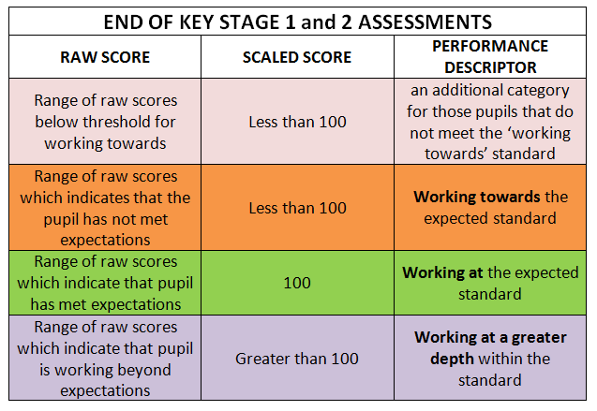
TESTS: Scaled scores
Greater than 110

Slide 12
The KS2 tests consist of:
  English grammar, punctuation and spelling Paper 1: short answer questions
  English grammar, punctuation and spelling Paper 2: spelling
  English reading: reading booklet and associated answer booklet
  Mathematics Paper 1: arithmetic
  Mathematics Paper 2: reasoning
  Mathematics Paper 3: reasoning

Slide 13
Test week 2024 for Y6 pupils
 | Subject | Time | Marks/ raw score
Monday 13th May | English grammar, punctuation and spelling: Paper one- short answer questions | 45 min | 50
 | English grammar, punctuation and spelling: Paper 2-spelling | 15 min | 20
Tuesday 14th May | English reading: reading booklet and associated answer booklet: 3 texts | 60 min | 50
Wednesday 15th May | Maths paper 1:arithmetic | 30 min | 40
 | Maths paper 2: reasoning | 40 min | 35
Thursday 16th May | Maths paper 3: reasoning | 40 min | 35

Slide 14
KS2 Grammar, punctuation and spelling test
National curriculum-
  Sets out technical terms in grammar to be learnt - these are explicitly included in the test
  Defines precise spelling patterns and methodologies to be taught - these are the basis of spellings in the test
Focuses on knowing and applying grammatical terminology with the full range of punctuation tested
There will be no contextual items in the test
Paper 1: short answer questions
Paper 2: Spelling - pupils complete by writing 20 missing words from transcript read by test administrator

Slide 15
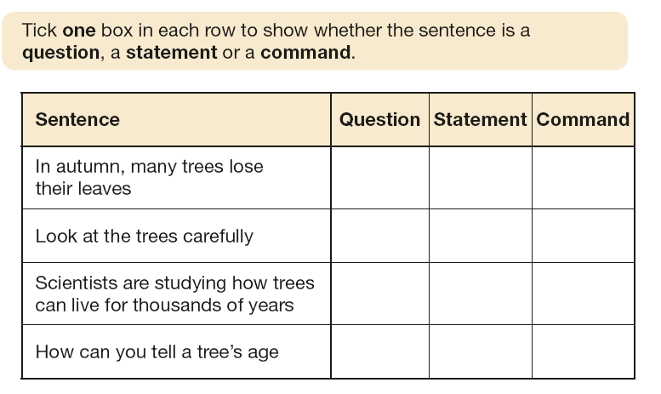

Slide 16
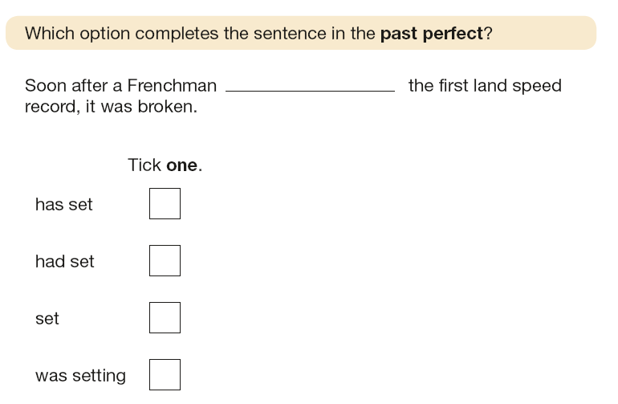

Slide 17
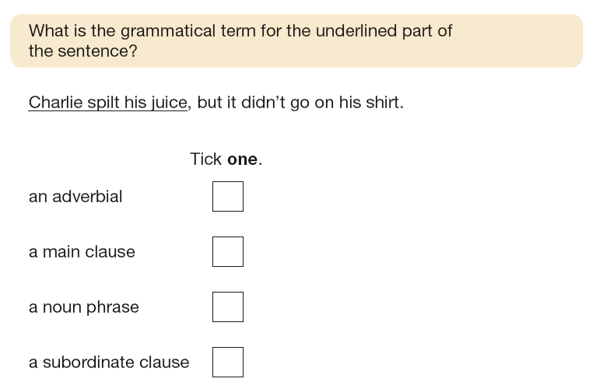

Slide 18
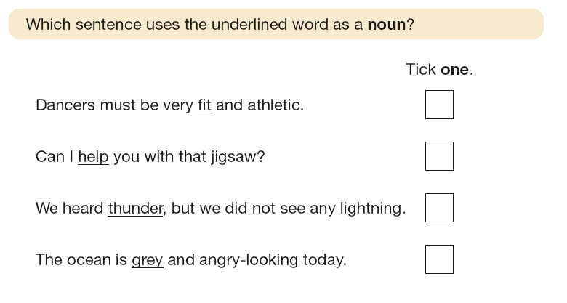

Slide 19
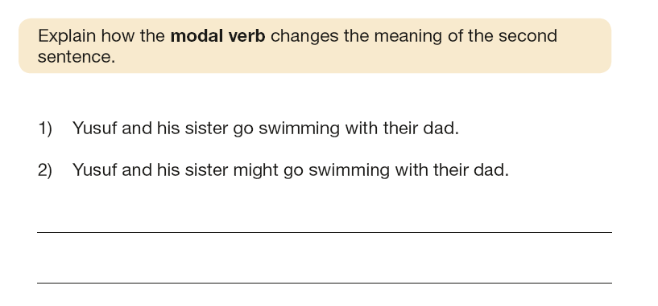

Slide 20
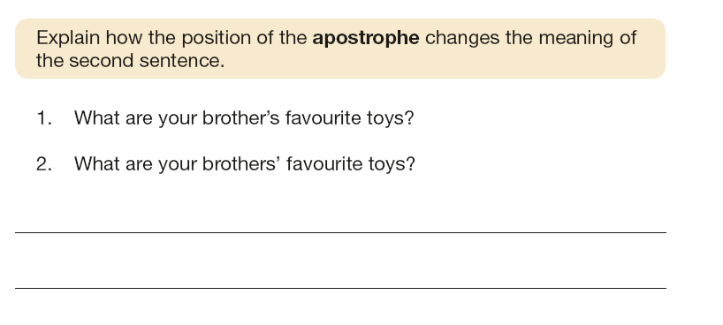

Slide 21
Spelling test words
Prefixes 3
Suffixes 2
shun endings 2
ably / ibly 2
words with silent letters 1
Homophones 1
discover
mission
loose
sign
country
gymnastics
edible
posture
sleigh
delicious
scent
illusion
re-enter
parachute
abundance
unavoidably
dissolve
ominous
drawer
possession
Spelling test

Slide 22
KS2 Reading test
greater focus on fictional texts
mixture of genres
least-demanding text first, following texts increasing in difficulty
A lot to read in the time provided
Roughly 6 sides of A4 to read and about 35 questions in 60 min
Reading stamina is key

Slide 23
Reading: question types
questions assessing vocabulary in context
requiring pupils to provide synonyms/explanations for vocabulary
inferring from the text
requiring pupils to identify language features
sequencing and ordering events
requiring pupils to comment on author’s choices
requiring pupils to recognise the difference between a fact and an opinion
comparison of information within the text

Slide 24
Task:
You have five minutes to read
‘Grannie’ on P6 in the booklet.

Slide 25
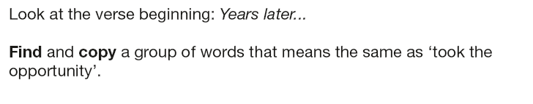

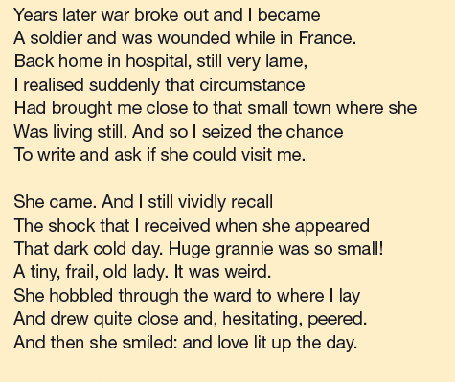

Slide 26
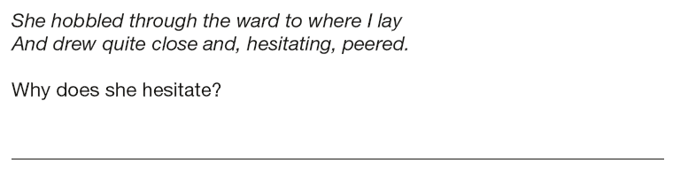
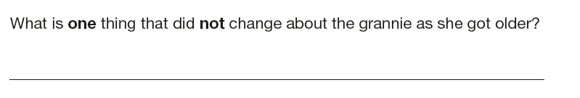
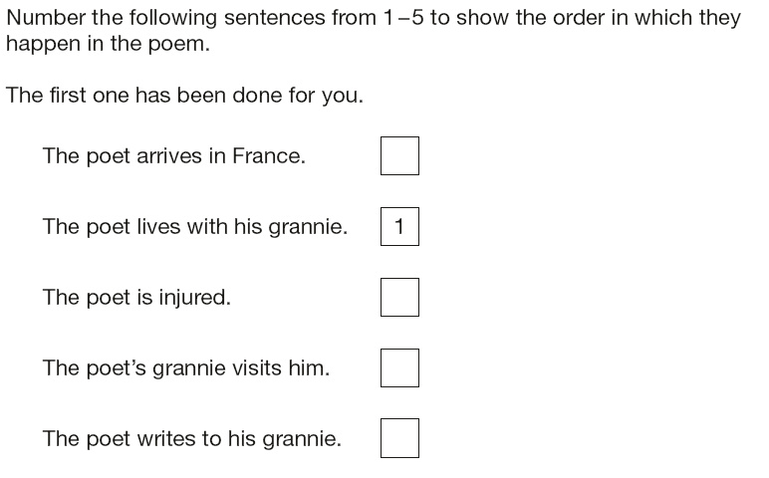

Slide 27
KS2 mathematics test
3 papers
Paper 1: Arithmetic, Paper 2: Reasoning and Paper 3: Reasoning
The arithmetic test assesses basic mathematical calculations:
  -questions cover straightforward addition and subtraction
  more complex calculations with fractions
  long divisions and long multiplications worth 2 marks each
Papers 2 and 3 each consist of a single reasoning test paper

Slide 28
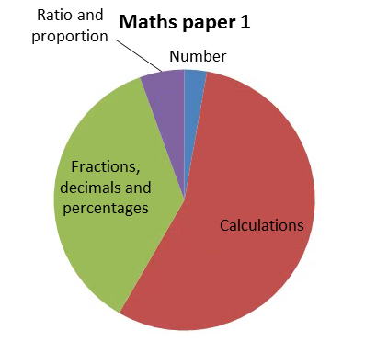
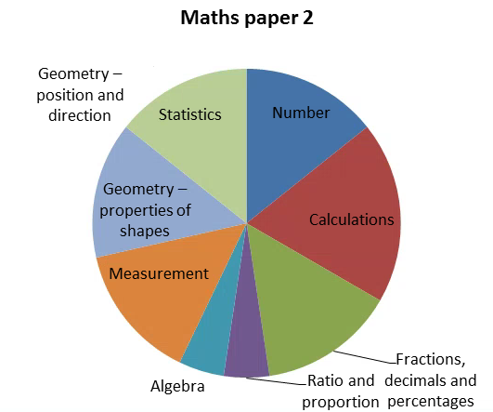
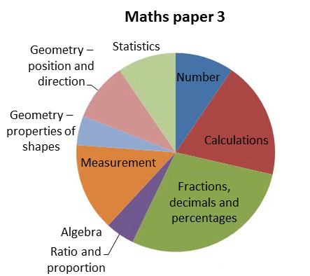

Slide 29
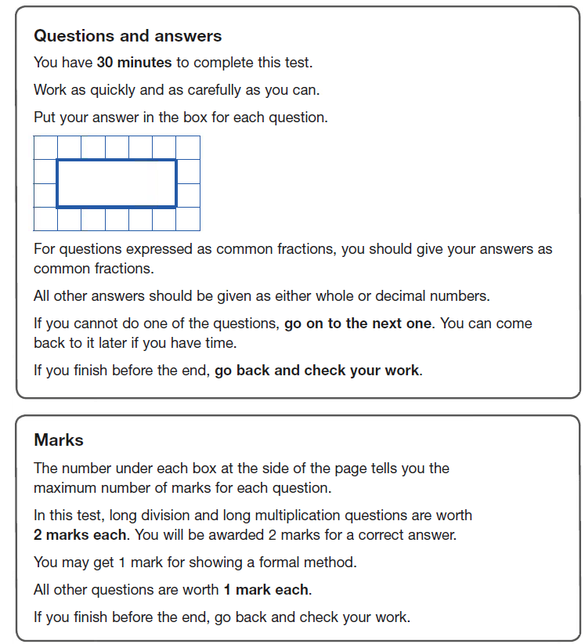
Maths paper 1: arithmetic
36 questions in 30 min
Some questions require children to show method
Questions increase in difficulty
Variations in how calculation is stated

Slide 30
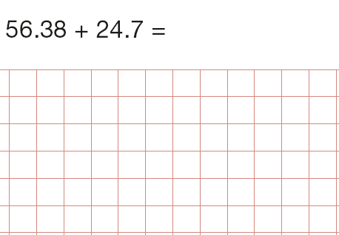

Slide 31
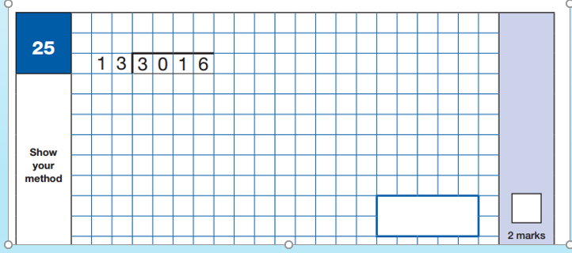
Your turn…

Slide 32
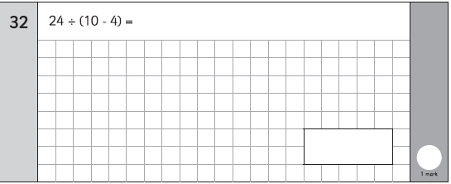
What do the children need to look out for here?

Slide 33
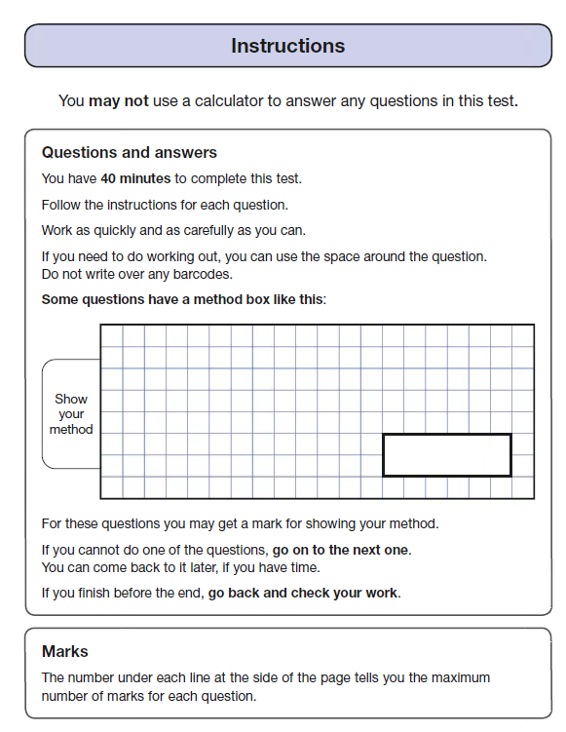
Maths papers 2 & 3: Reasoning
Potential challenges
Mathematical vocabulary
Phraseology of questions
Written explanations required
20 questions in 40 min
Variety of styles

Slide 34
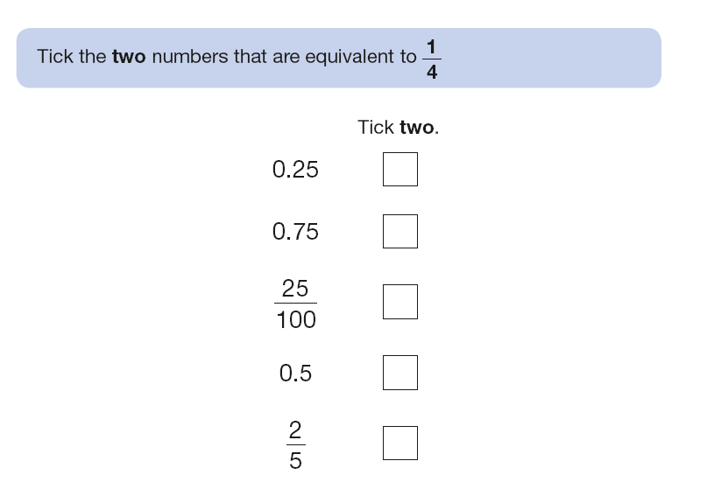

Slide 35

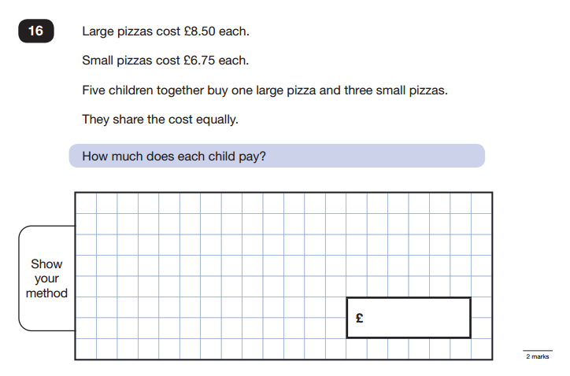

Slide 36
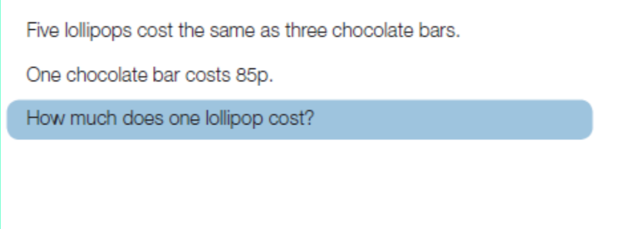

Slide 37
Teacher Assessment
As well as tests for Reading, Grammar and Maths
there are teacher assessments made and reported to parents
Writing is teacher assessed only - there is no formal test
Science is teacher assessed only- there is no formal test
A range of pieces are used to assess outcome
Participation in class and attitude to learning
Effort towards homework
Regular participation in external moderation to ensure consistency of judgements

Slide 38
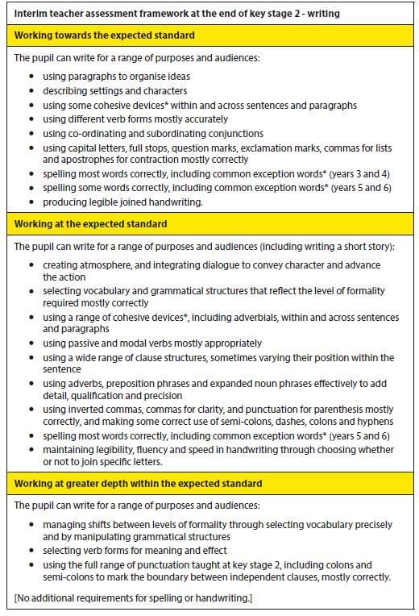
Writing standards:

Slide 39
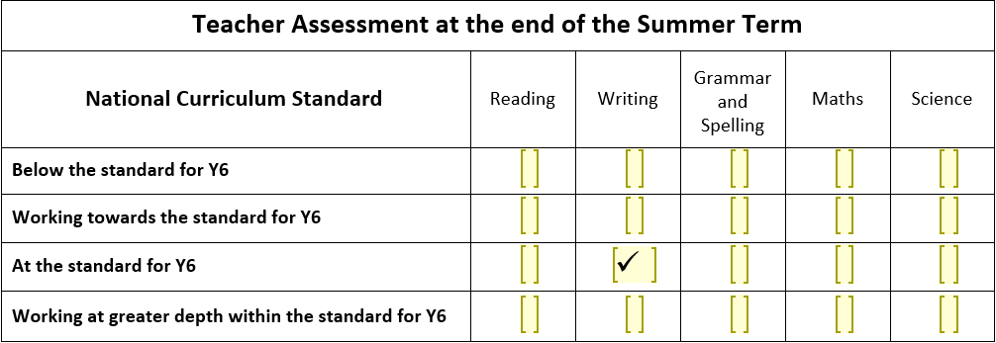

Slide 40
After the SATs
Grammar, punctuation and spelling, Reading and Maths Papers will be sent away to external markers
Return the second week of July
Analysis of the results
Reporting to parents

Slide 41
Help us to help them
We strive to maintain a normal timetable - a balance of all subjects - not just test subjects
We value all the work they have done over the last four years and encourage the importance of them achieving the highest score they can
We make it clear that whatever school they are going to, or planning to try for - their results are important and used by their teachers to set them
We ensure the children experience as little stress as possible
We need you to give them the same message

Slide 42

Year 6
There are only 56 teaching days until SATs!
Any questions?

